Slide 1
Ames, Iowa in Focus: Using Pertinent Economic Data to Predict Housing Sales Prices
Sonny Desai, Northwestern University
Contact: sjdesai87@gmail.com

Slide 2
Research question & modeling problems
Research Question(s): Expanding on the vast Ames, Iowa dataset with select Economic variables, can we create models that will help predict future sales price in the year 2020 based upon the homes’ measurable data and qualities, coupled with five new economic factors. The goal is to use the original dataset merged with the economic factors for the years 2006-2010 to predict upon a dataset with the years 2011-2019 to find 2020 sales prices for homes in Ames, Iowa.
The Ames, Iowa dataset is very large, but the variables all revolve around characteristics of the homes themselves. There are no specific variables detailing the economic situation which would affect the final sales price of the homes.
This project collected economic data for Population, Unemployment Rate, Median Household Income, Property Tax Valuation, and Housing Price Index (HPI) and merged it with the original dataset to use economic factors to predict future sales prices.
Regression models were chosen because the project is trying to approximate an unknown function (future sales Price). Classification would have required a randomized dataset using the Ames, Iowa data features.
The models created were linear regression, lasso, ridge, elasticnet, support vector regression, light gradient boost regressor, xg gradient boost, as well as a scaled down version of the dataset with Principal Components Analysis (PCA).

Slide 3
About the data…
The original dataset covers housing and location information concerning homes in the Ames, Iowa area. The data has both categorical and non-categorical variables and has numerous features with missing or null values.
It consists of 2,930 observations and a large number of explanatory variables (23 nominal, 23 ordinal, 14 discrete, and 20 continuous).
The data set covers 1,500 residential homes in Ames, Iowa consisting of data from taken from the years 2006 to 2010.
This original dataset was expanded with the Economic variables and split into two datasets: one with the years 2006-2010 to test the models on, and another with the years 2011-2019 to use as the test for the predictor regressors.
Population and Median Household Income data was gathered from the Census Bureau database, Unemployment Rate was gathered from the U.S. Bureau of Labor and Statistics, Housing Price Index was gathered from the St. Louis Fed, and Property Tax Valuation was gathered from the Iowa Department of Revenue.
This project focused on the response variable of Sales Price, which was used as the predictor against the expanded dataset.

Slide 4
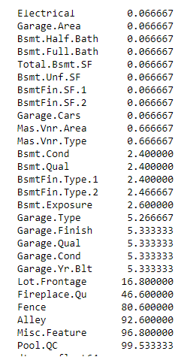
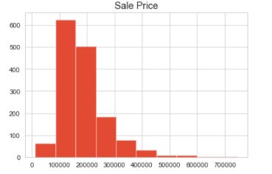
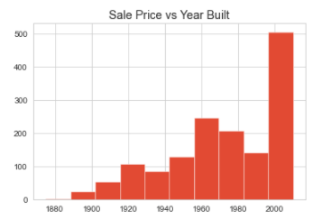
Exploratory data analysis (EDA)
The most glaring weakness of the original dataset was the large number of variables with null or missing values. . For the features that had a percentage missing of greater than 40%, the variables were dropped. This was due to the fact that filling this missing data with a mean value would be too inaccurate. For the remaining data, the values were replaced with the mean value for the variable.

Slide 5
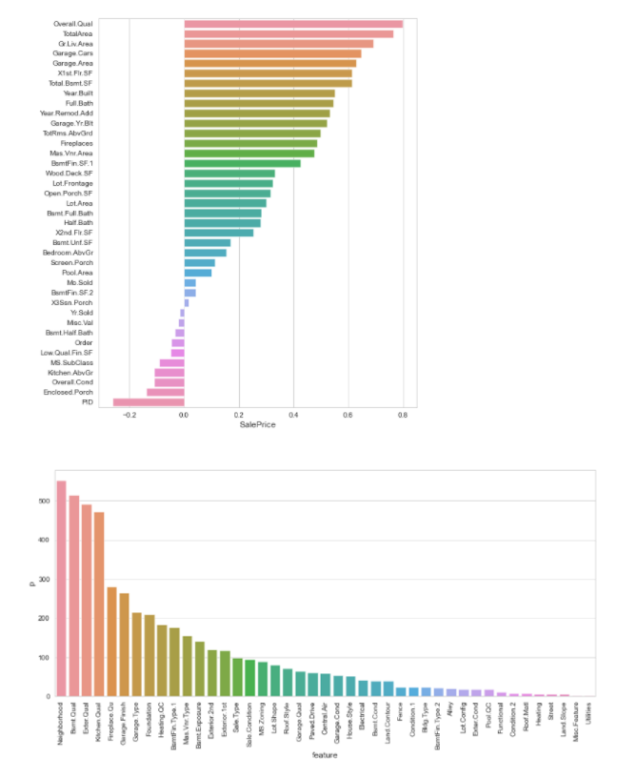
Exploratory data analysis (EDA)
These two charts first show the correlation of the quantitative or continuous variables, followed by a chart of the qualitative or categorical variables.
The quantitative chart surprisingly shows that most of the features to have some correlation to the feature variable. The highest performing ones were overall quality, total area, and the garage features. The qualitative chart, in turn, shows a lot of features with a with very low correlation to the data. The highest performing features were Neighborhood and quality of the room types in the home.
Instead of removing these low performing features, PCA was applied to reduce the number of dimensions and components with the regression models being tested again on the PCA reduced dataset. This was done to put more emphasis on the economic data, and to allow all features, even those with low correlation, to have impact on the model.

Slide 6
Exploratory data analysis (EDA)
To deal with the qualitative data, dummy variables were created that turned these categorical variables into continuous ones by transposing the data in multiple new variables with a 1 for present data, and 0 for without.
Multiple variables were reviewed as potential features to add as the new economic features to be added to the original dataset. Health variables were also explored but because of the quality of the economic variables, they were not included.
Population was chosen for its affect on demand, with a larger population needing a larger housing supply. Unemployment rate and median household income were both selected for its economic value, with each variable suggesting the potential buying power of the residents. Housing price index was a natural feature because of its close link to supply, demand, and property valuations of the homes in Ames. The last value, was the only variable that data could not be found for Ames, Iowa specifically. Instead, property valuations for the entire state of Iowa were chosen because of its economic affect

Slide 7
Research Design and Modeling Method
The first model tested was a Linear regression model without additions or specific weights. The next two models tested were Lasso and Ridge, which have the benefit of using the math of linear regression models but with techniques to reduce model complexity and prevent over-fitting.
For the elasticnet model, a random_state was added and set to one, which took one variable and randomly updated.
Next was a support vector regression model which added a standard scaler to the data which removed the mean and scaled to unit variance, and important part of removing variance form the model. After much testing C, which is the regularization parameter was set to 999999, and epsilon, which specifies the epsilon-tube within which no penalty is associated in the training loss function with points predicted within a distance epsilon from the actual value, was set to 1.
PCA and standard scaler were also applied to the dataset and again tested with some of the regression models. Standard scaler removed the mean and scaled to unit variance. PCA reduces the number of components and dimensions of the data to results in a smaller dataset.

Slide 8
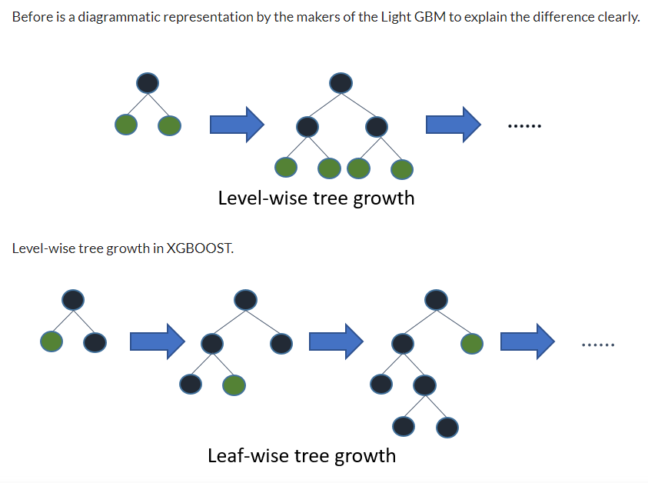
Research Design and Modeling Method
The next model was the highest scoring model, lightgbm. Here, the objective was set to regression, and four leaves were chosen. The lighgbm is based on decision tree algorithms, it splits the tree leaf-wise with the best fit whereas other boosting algorithms split the tree depth-wise or level-wise rather than leaf-wise. So, when growing on the same leaf in Light GBM, the leaf-wise algorithm can reduce more loss than the level-wise algorithm and hence results in much better accuracy which can rarely be achieved by any of the existing boosting algorithms. Learning rate which has to be less than 1, was set to .1 which was the advice given for higher accuracy. Number of estimators was set to 50,000; max_bin, the max number of bins to bucket the feature values was set to 2000000; bagging_fraction, specifies the fraction of data to be used for each iteration and is generally used to speed up the training and avoid overfitting, was set to .5555; baggin_freq was set to 1; baggin_seed was set to 5; feature_fraction, specifies the fraction of features to be taken for each iteration, was set to .99; feature_fraction_seed was set to 100; verbose was set to 5.

Slide 9
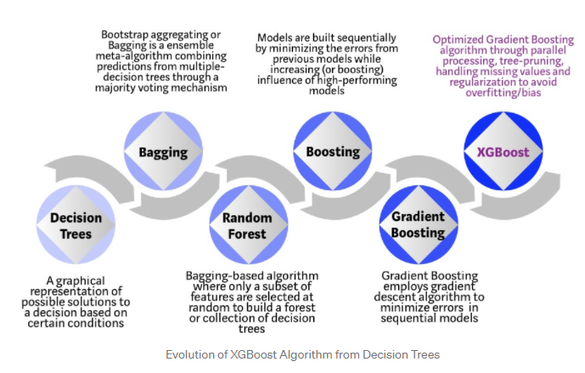
Research Design and Modeling Method
The last model tested was the xgboost, a very similar model to the lightgbm model. Xgboost is slower, and considered to be less accurate than lightgbm. The parameters for this model were objective set to linear regression; colsample_bytree, the subsample ratio of columns when constructing each tree. Subsampling occurs once for every tree constructed and the parameter was set to .9; learning_rate which helps reduce overfitting by shrinking the feature weights to make the boosting process more conservative, was set to .9; max depth, the maximum depth of a tree, with more depth increasing the complexity of the model, was set to 500. This low amount paired with a high learning-rate were both used to check against overfitting. Alpha, regularization term on weights, was set to 100 to make the model more conservative. Lastly, n_estimators was set to 1000.

Slide 10
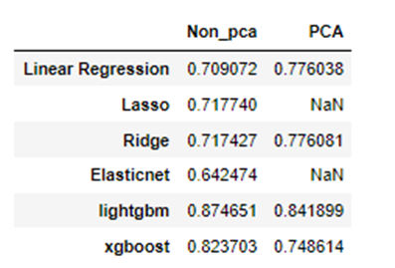
Results
The results showed that the models with gradient boosting performed the best, while the linear regression models without weights or PCA performed the worst. The Linear regression model was the worst performing model, with the lasso and ridge performing better.
PCA was also applied to the dataset and several models were run with the reduced dimension data. Interestingly, the models that performed poorly without PCA data, performed higher with PCA data, whilst the models that performed highly without PCA data performed poorly with PCA data. These were mainly the gradient booster models which had the highest scores without PCA but performed poorly with PCA. Linear regression, and Ridge performed better with the PCA data.
The results of the lightgbm model, (the highest performing) showed that predicted prices for homes in 2020 are more expensive than the original sales price, suggesting that changing economic factors drive the prices up.

Slide 11
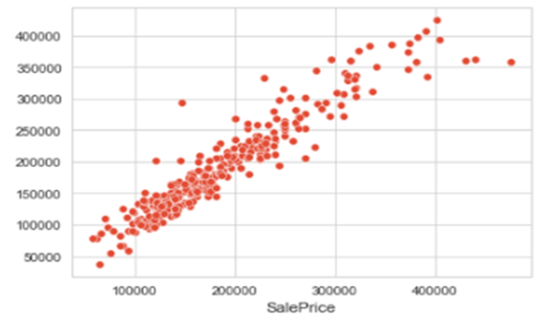
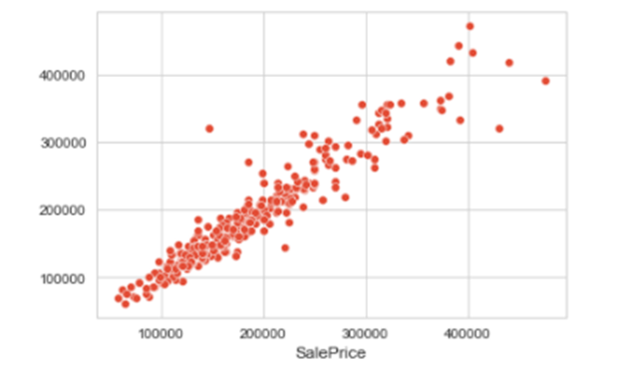
Comparison of models & Analysis
As noted previously, the gradient boosting models performed the best. This can be best understood by understanding the difference between the gradient boosting and normal regression. Gradient boosting converts weak learners into strong learners and splits the regression model into trees. The simple linear regression model does not have any weights, but the ridge and lasso models have weights built into the model. It is no surprise that they performed better than the linear regression model.
The first model, the lightgbm shows a much tighter line, with the majority of homes evenly distributed in the first half of the graph. The more expensive homes also follow this tight line and do not have too wide of a variance. This can be contrasted sharply with the second chart showing the linear regression model results. This chart shows the values less evenly distributed with wide variance in both halves of the chart. The first half shows variance for the lower priced homes as well as more variance in the middle to high priced homes. The difference between the charts can be boiled down to the successes of their predictor models respectively. The weights clearly had a positive affect on the accuracy of the model, and by adding gradient boosting, the data was able to be split into leaves and weaker learners strengthened.

Slide 12
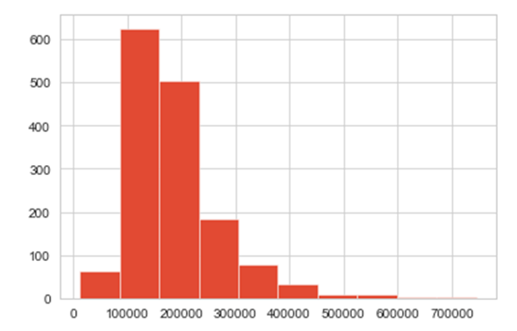
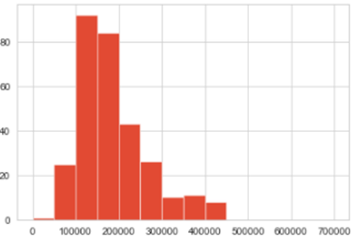
Comparison of models & Analysis
The first histogram shows the data for the original sales price with most of the homes in the 100-250k range with a sharp drop off after 200k priced homes. The second histogram, showing the predicted sales price on the split test dataset shows a clear difference. First, there is less of a drop off from the 150k-200k homes suggesting the prediction shows more homes in that sale price. There is a far less steep drop off after the 200k mark showing there are more homes priced in the 250-350k range. There are no higher priced homes, instead there are more homes in the 400-450k range suggesting that the high prices homes have dropped in price suggesting the limited test dataset had an affect on the outliers of high priced homes.
Changed economic factors lead to an increase in sales price throughout the range of homes. The most significant bump comes from the 200-350k range suggesting that many of the homes from the 100k-150k range have increased in sales price. Our economic predictors all changed significantly from 2006 to the last year assessed, 2019, suggesting the economic factors of increased population, median household income, housing price index, property tax valuation and decreased unemployment rate all had a significant impact on the prediction of sales price.

Slide 13
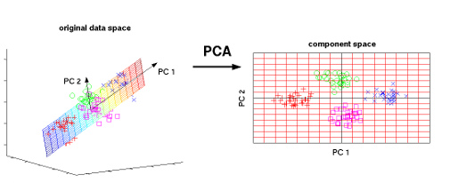
Comparison of models & Analysis
Lastly, the PCA reduced data was also interesting to note. The expectation was that PCA reduced data would have a significantly strong impact on the accuracy of the prediction models. However, interestingly, the highest performing models performed worse with PCA. These models were gradient boosting models which suggest that more dimensions helps impact gradient boosting, especially at the parameters that were set. PCA did have a more positive impact on the models without gradient boosting which seems logical as the reduced data helped impact the accuracy of the models without significant weights. By dropping the weaker learners and low correlated features by dimension reduction, the PCA acted in lieu of weights and helped increase the accuracy of the regression models.

Slide 14
Final thoughts & Future research
In sum, increased population, median household income, housing price index, property tax valuation and decreased unemployment rate all had a significant impact on the prediction of sales price. The changes between the years 2006 to 2019, showed that sales prices for homes increased across the board with the most significant increase for homes priced in the 150-350K range. These results were taken from a lightgbm predictor model without PCA data. Interestingly PCA data actually reduced the accuracy scores of our highest predictors, the gradient boosting predictors, while having the expected positive impact on the regressors without added weights.
This project covered a lot of topics: economic data, various regression models, and PCA reduced dimensions data. These topics leave a lot to be expanded upon in future iterations of this project, mainly around the economic data and models chosen. Future iterations can try to get more specific with the data, correlating specific sales month with the monthly value of the economic factor for that month and year instead of just the yearly rate. More economic and health factors could be viewed as well, such as new homes constructed, cost of labor and supplies for new homes or renovations, as well as health and transportation factors. For modeling, regression was used in this project, but clustering and classification could also be tested, especially if more relevant data around the homes are revealed. Lastly, parameters for the models could be adjusted and more weights added to the models to increase accuracy and minimize variance.

